Slide 1
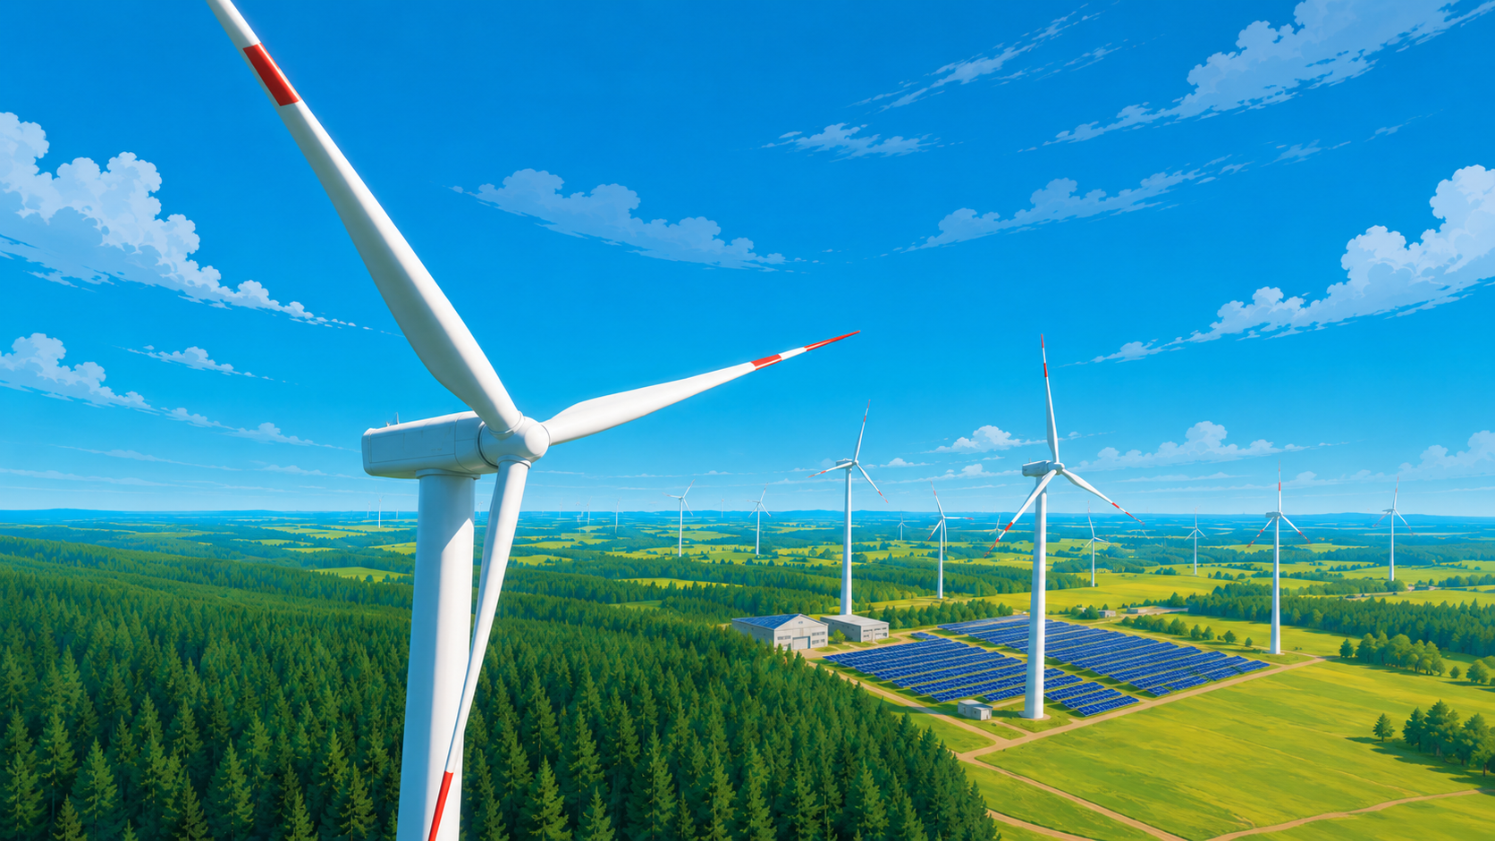
INOX GREEN ENERGY SERVICES LIMITED
Q1 FY27 RESULTS PRESENTATION
AUGUST 2026

Slide 2
SAFE HARBOUR
This presentation and the accompanying slides (the “Presentation”), which have been prepared by Inox Green Energy Services Limited (the “Company”), have been prepared solely for information purposes and do not constitute any offer, recommendation or invitation to purchase or subscribe for any securities, and shall not form the basis or be relied on in connection with any contract or binding commitment whatsoever. No offering of securities of the Company will be made except by means of a statutory offering document containing detailed information about the Company and in compliance with applicable SEBI Regulations.
This Presentation has been prepared by the Company based on information and data which the Company considers reliable, but the Company makes no representation or warranty, express or implied, whatsoever, and no reliance shall be placed on, the truth, accuracy, completeness, fairness and reasonableness of the contents of this Presentation. This Presentation may not be all inclusive and may not contain all of the information that you may consider material. Any liability in respect of the contents of, or any omission from, this Presentation is expressly excluded.
Certain matters discussed in this Presentation may contain statements regarding the Company’s market opportunity and business prospects that are individually and collectively forward-looking statements. Such forward-looking statements are not guarantees of future performance and are subject to known and unknown risks, uncertainties and assumptions that are difficult to predict. These risks and uncertainties include the effect of economic and political conditions in India, volatility in interest rates, new regulations and Government policies that may impact the Company’s business as well as its ability to implement the strategy, the Company’s future levels of growth and expansion, technological implementation, changes and advancements, changes in revenue, income or cash flows, the Company’s market preferences and its exposure to market risks, as well as other risks. The Company’s actual results, levels of activity, performance or achievements could differ materially and adversely from results expressed in or implied by this Presentation. The Company assumes no obligation to update any forward-looking information contained in this Presentation. Any forward-looking statements and projections made by third parties included in this Presentation are not adopted by the Company and the Company is not responsible for such third-party statements and projections.

Slide 3
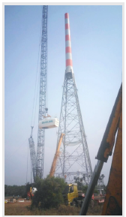
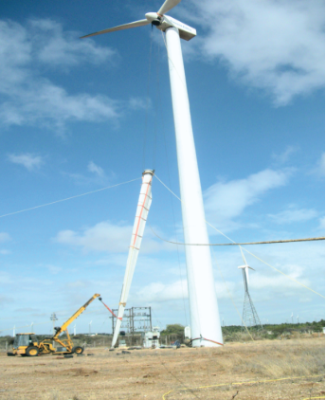
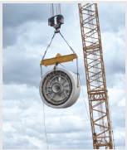

Contents
Key Highlights of the Quarter
Leaders in Energy Transition
Inox Green – Renewable O&M Business – Annuity With Growth
Renewable Sector in India – A Multi-Decadal Growth Story
Key Financials

Slide 4
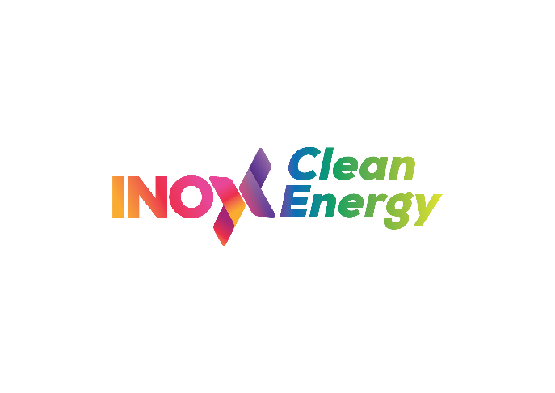



INOXGFL Renewables Adopts ‘ONE INTEGRATED’ Strategy
Inox Green : GROUP SYNERGIES TO BE THE NEXT ENGINE OF GROWTH
Inox Clean, the renewable IPP and solar cell & module manufacturing company of the Group; poised to become one of the leading renewable platforms globally
Fastest to reach an operational capacity of ~ 3.2 GW (within 16 months) → On track to reach 6 GW operational capacity by FY27
Planned annual capacity addition of 3 GW+, with a targeted operational capacity of 14GW by FY29
  ~ 20% - 30% of the above annual capacity addition is expected to be wind → translating into a multi-year recurring order visibility for Inox Wind
One of India’s largest wind turbine manufacturing players
Robust orderbook of ~ 4.4 GW as on July’26
On track to launch 4X MW WTGs which will help deepen market penetration
Provides visibility for multi-year multi-GW portfolio growth for Inox Green
EPC arm of the Group for both solar and wind
Fully integrated services including evacuation infra development, erection & commissioning of WTGs and modules, transformers and cranes amongst others
Transitioning to offer high value added products across power electronics
Multi-GW plug and play evacuation infrastructure in place – providing a critical ‘moat’ and growth opportunity
On a massive growth journey ahead with multi-year order book visibility
On the cusp of a massive transformation
Virtuous cycle of inter-play within Group entities aiding execution and revenue
Group synergies and businesses secure large growth and insulate from market cycles
Notes:
NCLT approval received dated March 13, 2026

Slide 5
Key Highlights
For the quarter, Inox Green reported:
  Total income of Rs 101 crores in Q1 FY27 vs Rs 86 crores in Q1 FY26, up 17% YoY
  EBIDTA of Rs 57 crores in Q1 FY27, vs Rs 48 crores in Q1 FY26, up 19% YoY
  Profit before tax of Rs 54 crores, vs Rs 31 crores in Q1 FY26, up 74% YoY
  Profit after tax of Rs 41 crores in Q1 FY27 vs Rs 22 crores in Q1 FY26, up 86% YoY
  Cash PAT of Rs 55 crores in Q1 FY27 vs Rs 44 crores in Q1 FY26, up 25% YoY
Machine availability for the portfolio stood at 96.3% in Q1 FY27
Inox Green’s portfolio stood at ~13.3 GWp as of June 2026 (~10.5 GW of wind assets and the balance being solar assets). This also includes the investments made to acquire ~ 6.5 GW of operational wind O&M portfolio of two companies^
Post completion of the acquisitions and consolidation of financials, Inox Green’s consolidated EBITDA and PAT are expected to increase multifold
Wind World acquisition: Approval received from the Hon’ble NCLT, Ahmedabad for acquisition of the ~ 4.5 GW wind O&M portfolio of Wind World India Ltd (erstwhile Enercon India) → Transaction formalities expected to be completed in Q2 FY27, post which financial consolidation will take place
  Value accretive transaction → this milestone transaction offers significant scope to bring in operational efficiencies through enhanced service offerings, price and cost optimisation; integration initiatives under way
Demerger of the power evacuation business has been completed as on August 1 2026 (being the record date)
Particulars (Rs cr) | Q1 FY27 | Q1 FY26# | YoY % | FY26 | FY25 | YoY %
Total income | 101 | 86 | 17% | 426 | 252 | 69%
EBITDA | 57 | 48 | 19% | 210 | 123 | 71%
Profit before tax | 54 | 31 | 74% | 158 | 49 | 223%
Profit after tax | 41 | 22 | 86% | 103 | 22 | 373%
Cash PAT* | 55 | 44 | 25% | 158 | 34 | 362%
* Cash PAT = PAT + Depreciation + Deferred Taxes
^ Wind World O&M portfolio of ~ 4.5 GW in the process of being consolidated
# Restatement of financials due to discontinued operations

Slide 6
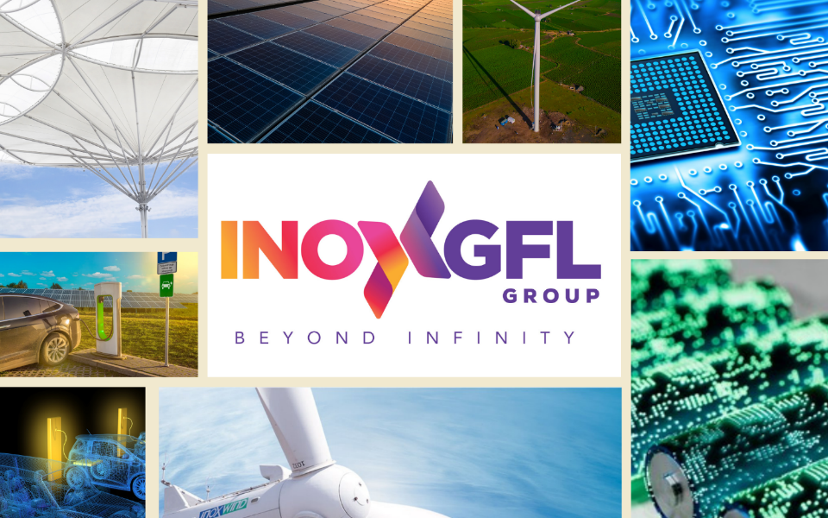
Leaders In Energy Transition

Slide 7


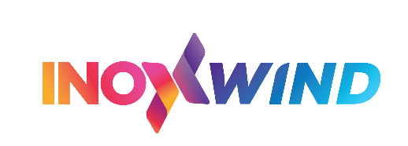

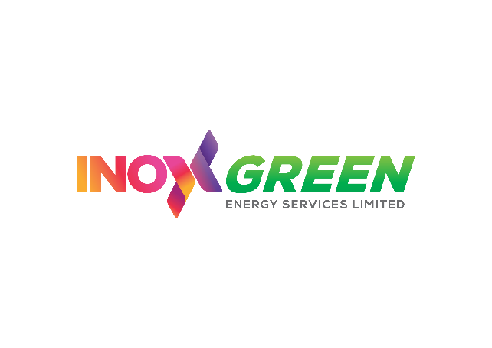



INOXGFL Group – USD 16 Bn Indian Conglomerate^
INOXGFL Group, with a legacy of over nine decades, and currently with three listed entities, is a leader in energy transition.
The Group is a forerunner in diversified business segments spanning fluoropolymers, fluorochemicals, battery chemicals, wind turbines, EPC, renewable O&M, solar cells & modules and renewable power generation.
Chemicals
Renewables
#
#
Gujarat Fluorochemicals Ltd. is a leading Indian Chemicals Company supplying fluoropolymers and fluorochemicals to the global market. It is the largest PTFE / fluoropolymer manufacturer in India. The company is developing products / grades across segments catering to new age businesses, including EVs, BESS & green hydrogen
Inox Wind is one of the leading fully integrated players in the wind energy market in India providing end-to-end turnkey solutions to customers. Its offerings include manufacturing and supplies of 2MW, 3MW and the upcoming 4MW class WTGs, EPC & infrastructure development (through subsidiary IRSL) and O&M (through subsidiary IGESL)
Inox Clean is the holding company of Inox Neo Energies, the RE IPP, and Inox Solar, the solar cell & module manufacturing entity
#
Inox Neo is a RE power generation platform targeting 14 GW of hybrid RE capacity – wind + solar + BESS by FY29.
Inox Solar is a fully integrated solar manufacturing player targeting 11 GW of solar cell & module manufacturing capacity across India and the USA
Battery materials company, a subsidiary of GFL
Catering to the EV/ESS ecosystem through Battery Salts, Additives, Electrolytes, CAM, Cathode Binders and NGAAM (Anode)
Subsidiary of GFL providing fluoropolymer solutions for the entire solar and green hydrogen value chain, including proton exchange membranes for electrolysers and fuel cells
Subsidiary of IWL (formerly Resco Global) offering a host of EPC services – resource assessment, site acquisition, project & evacuation infra development, erection and commissioning of WTGs and modules, cranes, transformer and power electronics manufacturing
Subsidiary of IWL; India's leading renewable O&M services player with ~ 13.3 GWp* of assets under management. Inox Green is India’s only listed pure-play renewable O&M service company.
^ As on June 30, 2026; INR:USD: Rs. 96
# Company listed on the Indian stock exchanges
* includes investment made by Inox Green to acquire ~ 6.5 GW of wind O&M assets, out of which, approx. 4.5 GW is in the process of being consolidated
Notes:
Market cap as on June 30 2026:
GFL: Rs. 44,000 crs
IWL: Rs. 14,500 crs
IGESL: Rs. 5700 crs
GFCL EV: Rs. 2540,000 crs
Inox Clean: Rs. 70,000 crs

Slide 8




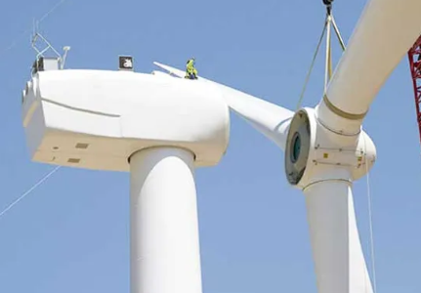
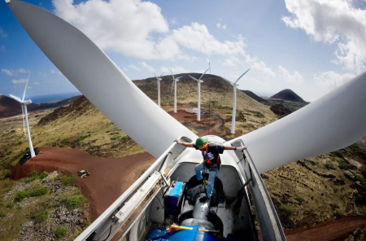




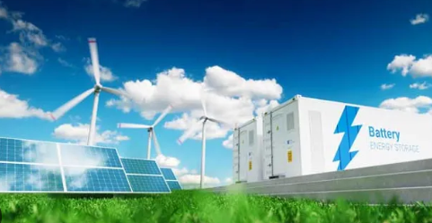

INOXGFL Group – Leaders In Energy Transition
INOXGFL Group is one of the most integrated players across the energy transition value chain
Manufacturing
Services
RE Power Purchase
RE Independent Power Producer

Slide 9
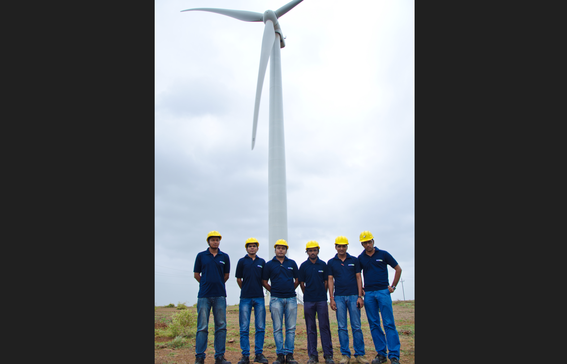
Inox Green – Renewable O&M Business – Annuity With Growth

Slide 10

Big beneficiary of the Inter-Play of Group Synergies
Comprehensive O&M Solutions Provider for WTGs, solar and common infrastructure for renewable power projects
Established track record in the wind energy O&M industry of >14 years
Technology driven company with focus on predictive maintenance over reactive maintenance
Strong support from sponsor, INOXGFL Group, a USD 16 bn Indian conglomerate with deep interests across chemicals and renewables
Reliable & Stable Cash Flows through long-term O&M services for wind and solar farm projects
Big beneficiary of the inter-play of Group synergies going forward → long term recurring portfolio growth visibility from Inox Wind and Inox Clean
Significant organic and inorganic growth opportunities across wind, solar and hybrid projects
Machine availability at ~96.3% for Q1FY27 registering a continuous improvement over the past years

Slide 11
A Compelling Growth Story
Inox Green’s ~ 13.3 GWp* O&M portfolio is spread pan India
Provides comprehensive O&M Solutions for WTGs, solar & hybrid projects as well as for the common infrastructure for renewable projects through long-term contracts of 5-20 years
Achieved pan India average machine availability of 96.3% in Q1 FY27
Presence across India with an established track record of > 14 years
Portfolio of ~13.3 GWp* of renewable O&M assets including ~ 10.5GW* wind and the balance being solar
Robust relationships with renewable asset owners – customers include PSUs, IPPs and private investors
Reliable & stable cash flows through long-term O&M services for renewable projects as well as value added services
Natural beneficiary of the WTG business of parent Inox Wind, hybrid project development, portfolio additions by Inox Clean Energy and inorganic growth plans
Strong technological capabilities with 24x7 centralized monitoring of assets and focus on preventive rather than reactive maintenance
Value-added services, which includes refurbishment, booster sales, carbon credit trading, amongst other offerings, is a high growth vertical
Haryana
Uttarakhand
2 MWp
23 MWp
Rajasthan
Uttar Pradesh
180 MWp
1109 MWp
1855 MW
Gujarat
233 MWp
2786 MW
Madhya Pradesh
Maharashtra
261 MWp
1161 MW
261 MWp
1052 MW
Karnataka
Andhra Pradesh
112 MWp
404 MW
Solar Energy
756 MWp
1341 MW
Kerala
Tamil Nadu
Wind Energy
16 MW
42 MWp
Wind + Solar assets
1078 MW
Solar assets
Map not to scale
Wind assets
* includes investment made by Inox Green to acquire ~ 6.5 GW of wind O&M assets, out of which, approx. 4.5 GW is in the process of being consolidated

Slide 12

Wind World India O&M Portfolio Acquisition | A Landmark Transaction
NCLT approval received for the acquisition of the ~ 4.5 GW wind O&M portfolio of Wind World India (erstwhile Enercon India) → transaction formalities expected to be completed in Q2 FY27, post which financial consolidation will take place
The acquired O&M portfolio services a marquee client base that includes the Tata Group, ReNew, Greenko Group, Apraava Energy and Hindustan Zinc, amongst others
The assets are spread across key wind-rich States including Karnataka, Maharashtra, Tamil Nadu, Rajasthan, Gujarat, Madhya Pradesh and Andhra Pradesh
The portfolio generated revenue of Rs. 580 crore in FY26 and benefits from contracted annual price escalation of approximately 5%
The transaction is value accretive for shareholders
There is significant scope to bring in operational efficiencies through enhanced service offerings, price and cost optimisation; integration initiatives under way
This is a marquee transaction in the renewable O&M sector and a milestone in the journey of Inox Green

Slide 13
Portfolio Of ~ 13.3 GWp of O&M Assets
Strong growth in O&M portfolio* since inception
Portfolio in GWp
Key Metrics
1
2
3
4
5
6
~13.3 GWp*
Multi-year residual duration of the O&M contracts
Up to 25 years
~4.4 GW
Rs 101 cr
Rs 57 cr
Current Portfolio
Tenor of O&M contracts
Net Order Book of IWL
Q1 FY27 Revenue
Q1 FY27 EBITDA
* includes investment made by Inox Green to acquire ~ 6.5 GW of wind O&M assets, out of which, approx. 4.5 GW is in the process of being consolidated

Slide 14


An Asset-light Growth-oriented Annuity Business Model
Asset-light balance sheet post the demerger; Focus: Long-term contracts with steady cashflows
Digital Transformation Initiatives of Inox Green
24x7 centralized monitoring of assets
Performance analysis & improvement
Inox Green provides Long-term O&M services for wind farm projects, wind turbine generators (“WTGs”), solar plants and the common infrastructure facilities of the renewable power projects.
Demerger of the power evacuation business has been completed as on August 1 2026 (being the record date)
Development of mobile-based O&M management tool
Upgradation to SAP HANA in progress
SCADA analysis
Scope of contracts include both comprehensive O&M and common infrastructure O&M
Annual Maintenance Contract
Annual Operations & Maintenance Contract
Semi-Comprehensive Operations & Maintenance Contract
Comprehensive Operations & Maintenance Contract

Slide 15
On Track To Become One of the Largest Renewable O&M Companies Globally
Inorganic growth opportunities
Customers across the board are looking for a switchover to a strong, credible, renowned and Indian O&M service provider. At Inox Green, we are well placed to capture this opportunity going forward.
Multiple opportunities to takeover O&M portfolios of large IPPs / developers who are currently managing majority of their portfolio captively.
Opportunities to enter into contracts with customers for projects where the existing contracts may have expired / are on the verge of expiring.
Organic growth opportunities
Growing the portfolio through new long-term O&M contracts with customers purchasing IWL’s WTGs – IWL’s order book of ~ 4.4 GW provides a very strong visibility.
O&M contracts from the Group IPP platform Inox Clean, which targets 3 GW+ of installed capacity addition annually, to add to the growing portfolio.
Revision/Reset of existing O&M contracts.
WTG overhaul package offerings to customers aimed at increasing the life of the turbines and enhancing their output.
Value added services to contribute meaningfully to the topline.

Slide 16
ESG Framework
Global Reporting Initiative Standard
Business Responsibility & Sustainability Reporting
Sources of emissions
Policy Structure & Certifications
Scope 1 emissions
Includes: Use of diesel
Total: 1009 tons CO2 equivalent
Reduction measures: Replacing diesel with greener fuels like CNG or use Electric Vehicles
Environment
Environment & Energy as part of IMS
ISO 14001:2015:- Environment Management System
Reducing emissions, water usage and waste generation
Scope 2 emissions
Includes: Purchased electricity
Total: 93 tons CO2 equivalent
Reduction measures: Using green energy for our business requirements
Guidelines on Human Rights
Corporate Social Responsibility Policy
Occupational Health & Safety
Equal Employment Opportunity
Stakeholder engagement
Social
Scope 3 emissions
Includes: Purchased goods and services, capital goods, fuel and energy related activities, waste generated
Total: 456 tons CO2 equivalent
Reduction measures: Purchasing goods with least carbon footprint
Board Diversity
Code of Conduct
Related Party Transaction Policy
Whistle Blower Policy
Data Policy
Governance

Slide 17
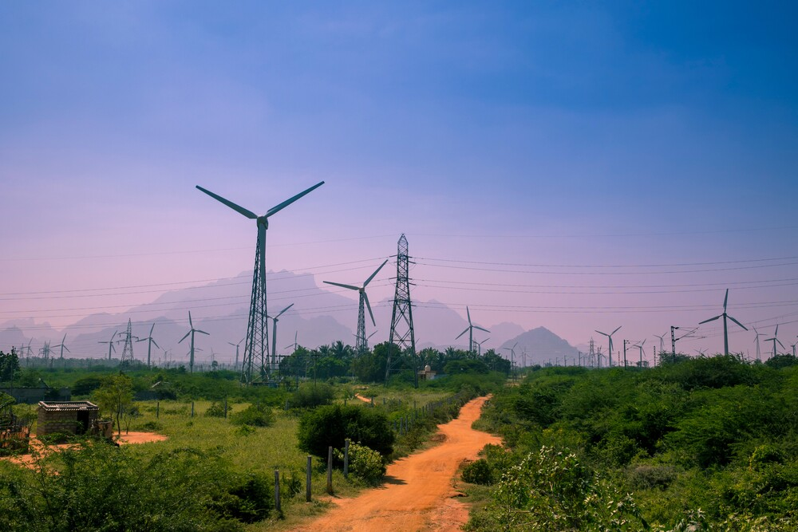
Renewable Sector in India – A Multi-Decadal Growth Story

Slide 18
India Renewable Sector – A Multi-Decadal Growth Story
India’s per capita electricity consumption expected to triple
Power Demand in BUs | Multi-year high demand in FY27 YTD
6% CAGR
Q1
Q2
Q3
Q4
Solar + Wind forms 40% of the total installed capacity
India targets 500 GW/1,800 GW of non-fossil fuel capacity by 2030/2047
Thermal
2047
Solar
2030
Hydro
(incl. small Hydro)
Current
548
GW
Wind
Other renewable
(Biomass, waste to
energy)
Nuclear
Solar
Wind
Others
Huge Potential for Growth – India’s onshore wind potential stands at 695 GW at 120m hub height and 1,164 GW at 150m hub height
Sources: NEP 2026, CEA, MoP, International Energy Agency, World Bank, JMK report

Slide 19
Strong Future Demand for Wind Installations Due to its Complementary Generation Profile to Solar
Highest Ever Wind Installations in FY26…
…With 8-10 GW Annual Wind Installations Expected in Near Term
MW
Installed Wind Capacity Expected to be 7x Current Capacity in the Next 2 Decades
10%
Sources: MNRE, MoP, CEA, International Energy Agency, JMK report, CII report
Notes:
Wind growth to outpace power; Strong 10% CAGR
projected against 6% growth in power consumption

Slide 20
Pure Wind Bids Highest In the Last 8 Quarters
Renewable capacity awarded
Out of 9.34 GW renewables capacity awarded through tenders in Q1 FY27, 4.55 GW (49%) comprised of wind/Hybrid/FDRE projects
9.34 GW
RE capacity Awarded in Q1 FY27
2.35 GW
1.20 GW
1.00 GW
1.34 GW
3.45 GW
Wind
FDRE
Hybrid
Solar
Solar Storage
13.9 GW renewable capacity added in Q1 FY27
India’s RE capacity (ex-large hydro): ~ 237 GW as of Jun’26
All-India RE capacity (excl large hydro of 51GW) reached ~ 237 GW in Jun’26
Sources: MNRE, CEA, MoP, Industry data

Slide 21
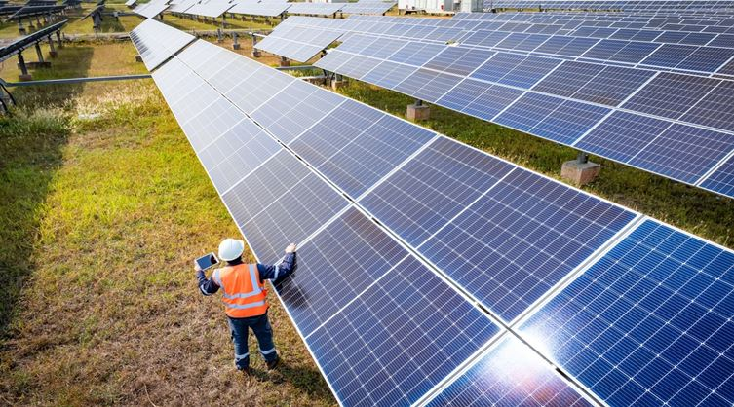
Key Financials

Slide 22
Key Financials – Consolidated Income Statement
Particulars (Rs cr) | Q1 FY27 | Q1 FY26# | FY26 | FY25
(a) Revenue from operation (net of taxes) | 43.3 | 52.4 | 281.0 | 220.2
(b) Other Income | 57.9 | 33.1 | 145.2 | 31.8
Total Income | 101.2 | 85.5 | 426.2 | 252.0
Expenses
(a) O&M, Common infrastructure facility expenses | 25.0 | 28.1 | 152.6 | 98.8
(b) Purchases of stock-in-trade | - | - | 10.2 | -
(c) Changes in inventories | - | - | - | -
(d) Employee benefits expense | 13.9 | 12.9 | 57.2 | 47.7
(e) Finance costs | 2.1 | 3.6 | 8.8 | 18.6
(f) Depreciation and amortization expense | 0.4 | 0.4 | 1.7 | 0.9
(g) Other expenses | 5.3 | 9.0 | 37.9 | 37.1
Total Expenses (a to g) | 46.7 | 54 | 268.4 | 203.2
Profit/(Loss) before & tax | 54.5 | 31.5 | 157.8 | 48.8
- Current Tax | 0.1 | 0.2 | 0.7 | 1.4
- Deferred Tax | 13.6 | 7.8 | 52.7 | 11.4
Total Provision for Taxation | 13.7 | 8.0 | 53.5 | 12.8
Profit/(Loss) after tax from continuing operations | 40.8 | 23.5 | 104.3 | 36.0
Profit/(loss) after tax for the period | 40.8 | 22.4 | 103.4 | 21.9
EBITDA | 57.0 | 47.7 | 209.7 | 122.8
Cash PAT* | 54.8 | 43.8 | 157.9 | 34.2
* Cash PAT = PAT + Depreciation + Deferred Taxes
# Restatement of financials due to discontinued operations

Slide 23



THANK YOU
Investor Relations
Contact No: +91 120 614 9600
Email : investor@inoxgreen.com
Follow us on Social Media:
This presentation and the related discussions may contain “forward looking statements” by Inox Green Energy Services Limited (“Inox Green” or “the Company”) that are not historical in nature. These forward looking statements, which may include statements relating to future state of affairs, results of operations, financial condition, business prospects, plans and objectives, are based on the current beliefs, assumptions, expectations, estimates, and projections of the management of Inox Green about the business, industry and markets in which Inox Green operates.
These statements are not guarantees of future performance, and are subject to known and unknown risks, uncertainties, and other factors, some of which are beyond Inox Green’s control and difficult to predict, that could cause actual results, performance or achievements to differ materially from those in the forward looking statements.
Such statements are not, and should not be construed, as a representation as to future performance or achievements of Inox Green. In particular, such statements should not be regarded as a projection of future performance of Inox Green. It should be noted that the actual performance or achievements of Inox Green may vary significantly from such statements.
Accordingly, this presentation is subject to disclaimer and qualified in its entirety, by assumptions and qualifications and therefore, the readers and participants are cautioned not to place undue reliance on forward looking statements as a number of factors could cause assumptions, actual future results and events can differ materially from those expressed in the forward looking statements.
23

